Slide 1

Making this resource work for you
Prior to teaching this lesson, please refer to the ‘Unit Overview and Planning Document’.
Further guidance on planning Science Mastery lessons can be found in the detailed planning guidance document.
Refer to the ‘notes’ section on each slide for useful information, including suggested expositions, pedagogical content knowledge, suggested questions, answers and more. Consider using presenter mode so you can see this guidance throughout the lesson.
The introduction slides can be adapted to suit your teaching style and the needs of your class.
Before the lesson, adapt the fix-it slide to address any misconceptions identified in the previous lesson’s exit ticket.
Choose from the suggested activities to suit your class. The intention is not that you complete all of these, but that you select those which ones are most appropriate for your students. It may be appropriate to further adapt activities for your students.
These lessons are designed to occupy approximately 1 hour. To adapt for a shorter or longer lesson duration we advise you to adapt the activity section accordingly.
Please consider using the final slide to send feedback about this lesson or examples of PowerPoints that you have adapted to our design team. Your feedback is used to improve Science Mastery for all of our teachers and students. We appreciate all suggestions and comments.
Thank you for reading!
The Science Mastery Team

Slide 2
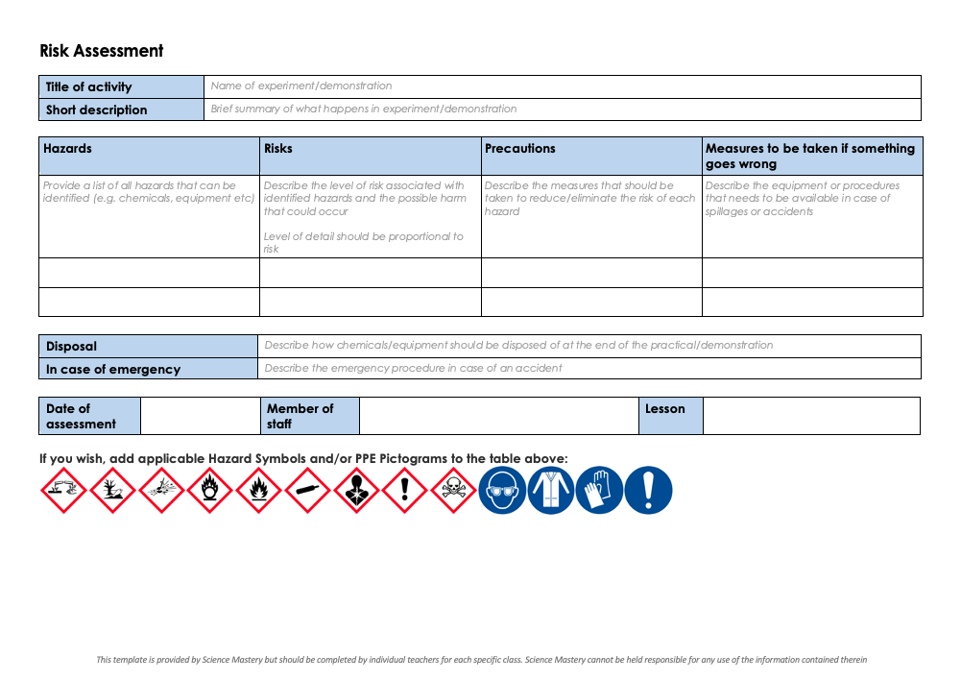
Practical Activity
This lesson contains a practical activity (either a whole class activity or a demonstration)
A risk assessment must be completed for this practical
The template risk assessment can be found here.
The risk assessment should be specific to the class involved and written only by the teaching member of staff
The risk assessment should refer to the current CLEAPSS Hazcards for all chemicals used in the practical for safety and disposal notes.
A list of chemicals used can be found in the Practical Guide
It is good practice for students to wear safety spectacles during all class practicals and demonstrations
Thank you for reading!
The Science Mastery Team

Slide 3
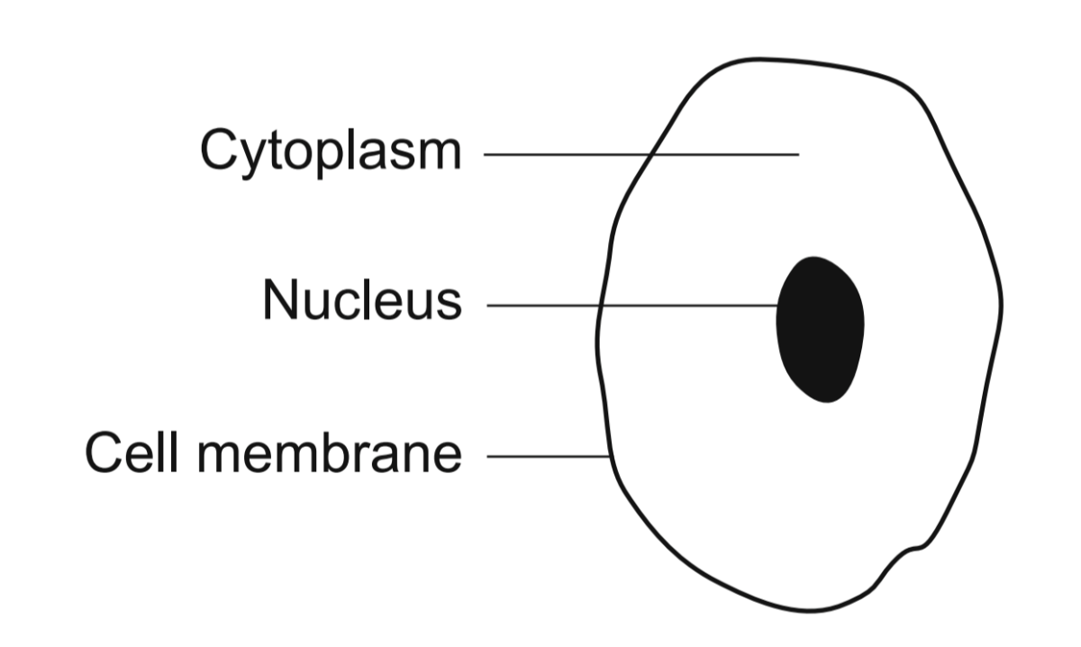
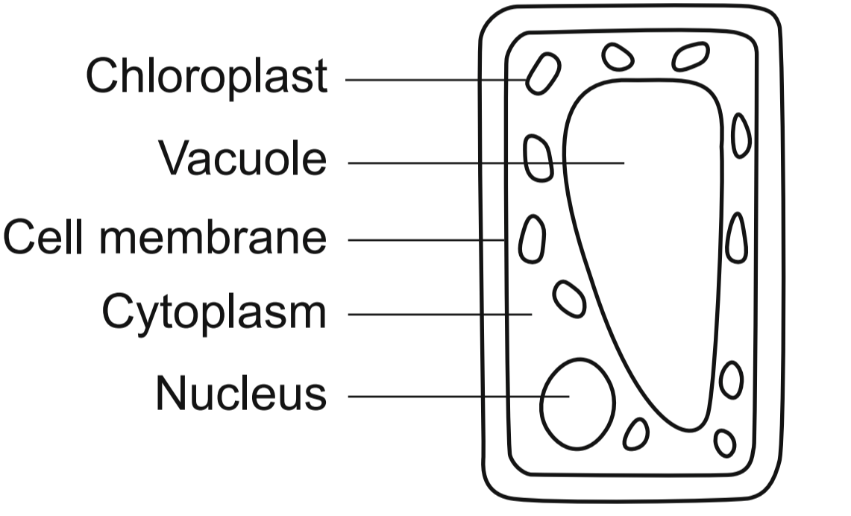
Osmosis
Answer the questions below:
Draw and label a plant cell and an animal cell.
Name the organelles that are found in plant cells but not animal cells.
Describe the role of the vacuole in plant cells.
State the word equation for photosynthesis.
Explain photosynthesis is important for food chains.
Cell wall, chloroplasts, vacuole
It stores water and nutrients and provides support for the plant cell.
Water + carbon dioxide → glucose + oxygen
Producers make glucose through photosynthesis and are then eaten by consumers who cannot make their own food.
Notes:
Foundation: What would happen to a plant if it was never watered?
Stretch: Explain why water is an important molecule.
Answers:
Foundation: It would die because it would not be able to photosynthesise.
Stretch: All food chains depend on photosynthesis, which requires water. If there was no water/photosynthesis there would be no food! Also, all biochemical reactions take place in solution, so without water there would be no respiration either.

Slide 4
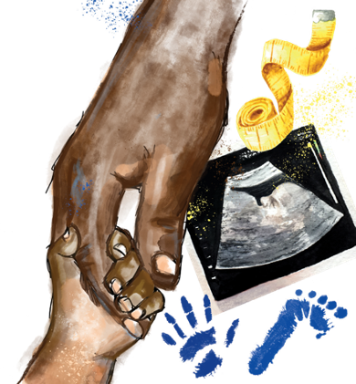

B3.1.9
01/10/2025
Osmosis
B3.1.1 Prior Knowledge Review
B3.1.2 Eukaryotic and Prokaryotic Cells
B3.1.3 Aseptic Technique
B3.1.4 Growth of Bacteria
B3.1.5 Microscopes
B3.1.6 Observing Cells
B3.1.7 Diffusion
B3.1.8 Diffusion in Living Things
B3.1.9 Osmosis
B3.1.10 Osmosis Investigation
B3.1.11 Active Transport
B3.1.12 Cell Division
B3.1.13 Cancer
B3.1.14 Stem Cells
Notes:
Big Idea: Cells are alive
Pupils will move on from their previous learning about diffusion to look at a ‘special case’ of diffusion in osmosis. In this lesson they will learn the theory, following it up with an investigation in the next lesson where they will practice calculating the percentage increase or decrease in mass to make inferences about relative concentrations.
Suggested Hook:
Pupils may have heard of isotonic sports drinks such as lucozade sport- you can ask pupils quickly for other brands or examples and in what scenarios are those drinks designed to be consumed (intense exercise or sport). In this lesson we are going to learn what an isotonic solution is and why isotonic sports drinks are very good at hydrating athletes.

Slide 5

Following this lesson, students will be able to:
Define osmosis
Describe the difference between hypertonic, hypotonic and isotonic solutions
Explain what would happen to an animal cell that is placed in a hypotonic solution
Key Words:
partially permeable
osmosis
hypertonic
hypotonic
isotonic
dilute
concentrated

Slide 6
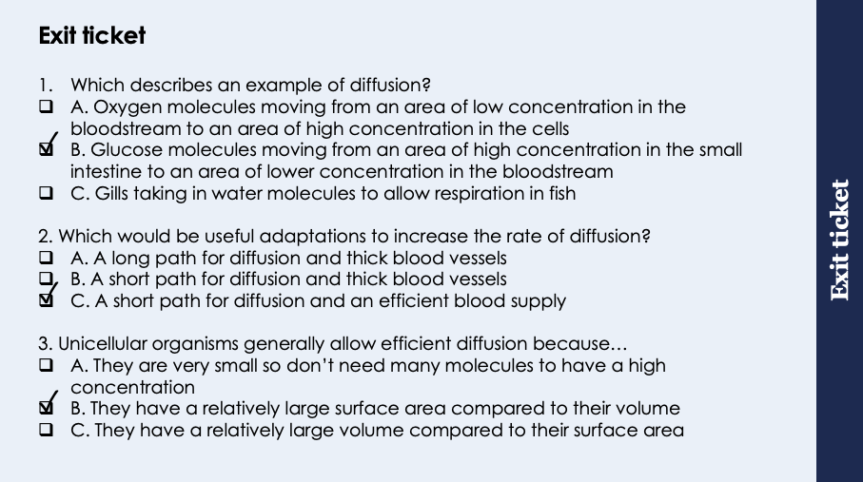
This is the fix-it portion of the lesson
The fix-it is an opportunity to respond to gaps in knowledge, especially those identified by the previous lesson’s exit ticket.
The teacher should customise this slide as needed, to facilitate
reteach, explanation, demonstration or modelling of ideas and concepts that students have not yet grasped or have misunderstood.
practise answering specific questions or of key skills.
redrafting or improving previous work.
Notes:
Purpose: to spend time on gaps identified in previous lesson’s exit ticket.
Answers:
Q1. Answer: B
If pupils answered incorrectly they have not got the correct definition of diffusion, A has the wrong concentration gradient and C links to water. To fix this ask pupils to write a scientific definition of diffusion and explain why it is useful.
Q2. Answer: C
If pupils answered incorrectly they do not know the adaptations to increase the rate of diffusion, both A and B indicate a misconception around the length of diffusion path. To fix this show diagrams of short and long diffusion paths and ask pupils to identify which one would reach equal concentrations sooner.
Q3. Answer: B
If pupils answered A they may have misunderstood that unicellular organisms need many substances just as multicellular organisms do. If they answered B there is a misconception around linking SA:vol to diffusion. To fix this explain Sa:vol in more detail and use diagrams to show how it can speed up diffusion.

Slide 7
Osmosis
Osmosis is the diffusion of water from a dilute solution to a concentrated solution through a partially permeable membrane
A partially permeable membrane (e.g. a cell membrane) is a membrane that lets particular substances through it, either in or out
Notes:
Purpose: introducing new knowledge
Type of exposition: Explanation
Suggested script:
So far we have looked at diffusion which is the movement of particles from a high to a low concentration. Today we are looking at a process which is specific to the movement of water particles. Osmosis is the movement of water particles from an area where there are many water particles (a dilute solution) to an area where there are fewer water particles (a concentrated solution) across a partially permeable (or semi permeable) membrane. Remember a cell membrane is an example of a partially permeable membrane.
In the diagram on the board the beaker starts with a dilute solution on the left hand side as there are fewer solute molecules dissolved in the water, on the right hand side is a more concentrated solution as there are many solute particles dissolved. Therefore water moves via osmosis from the left hand side to the right hand side because there are more water molecules in the left hand side dilute solution. The solute molecules are too big to pass through the membrane, so you only get movement of water here.
Like with diffusion osmosis is a passive process meaning it will happen naturally and does not require extra energy to happen. Osmosis will continue to happen until concentrations on either side of the semi permeable membrane are equal. At this point the water molecules will still move as they are in a liquid state but there will be no net movement of water.
Suggested guidance: when we use the word concentration it refers to the concentration of the solute.
Big misconception with osmosis is where pupils talk about dilute and concentrated solutions. For osmosis we are always looking at the movement of water but this can often be described as high water concentration to low water concentration. For explanations stick with consistent language, otherwise pupils can get confused if resources mention the movement of water from a low solute concentration to high solute concentration. Most straightforward is to use dilute and concentrated.

Slide 8
Osmosis
A hypertonic solution is one in which the external solution has a higher concentration of solute than the cell (e.g. salt water)
A hypotonic solution is one in which the external solution has a lower concentration of solute than the cell (e.g. distilled water)
An isotonic solution is one in which the external solution has the same concentration of solute as the cell
Notes:
Purpose: introducing new knowledge
Type of exposition: Explanation
Suggested Script:
We can compare cells to three different types of solution.
A solution that is more concentrated that the cell is a hypertonic solution. A solution that is less concentrated (so more dilute) than the cell is a hypotonic solution. Emphasise the difference in saying HYPER vs HYPO. Prefixes can be written on the board and linked to hyperthermia which is a high temp so hyper means high and hypothermia which is a very low temp so hypo means low. Some pupils may be familiar with hyper/hypo glycaemic too.
A solution that is equally as concentrated as a cell is known as an isotonic solution. Where have you heard the word isotonic before? Isotonic sports drinks such as Lucozade. Well, isotonic sports drinks are designed to have the same electrolyte concentration as your cells. You could link the prefix iso to isometric muscle contraction (pupils may have heard in PE) which is muscle contractions where muscles do not lengthen or shorten so stay the same length. Link to iso meaning equal.
Suggested guidance: when we use the word concentration it refers to the concentration of the solute.
Big misconception with osmosis is where pupils talk about dilute and concentrated solutions. For osmosis we are always looking at the movement of water but this can often be described as high water concentration to low water concentration. For explanations stick with consistent language, otherwise pupils can get confused if resources mention the movement of water from a low solute concentration to high solute concentration. Most straightforward is to use dilute and concentrated.
The three new words above can be represented using particle diagrams on the board using dual coding.

Slide 9

Can you explain the difference between these two terms?
Hypertonic
Hypotonic
Notes:
If they are struggling with the difference between hypertonic and hypotonic, you can use the word roots to help e.g. hyper (more) / hypo (less)thermia, hyperactive (more active). See guidance on previous slide.
Suggested guidance:
Talk tasks can be used in a variety of ways to suit the particular needs of the students you are teaching. Through exchanging views with others, students develop their understanding of the science beyond what could be achieved individually.
Science classrooms that successfully integrate talk have the following features:
Science talk is a regular feature of lessons and is woven into classroom activities.
Students are paired or grouped strategically by the teacher to ensure productive interaction. This might take into consideration the students’ proficiency of the English language, how encouraging they might be to peers and their attainment in the topic. It’s a good idea to consider these pairings in the class seating plan.
Students are encouraged and supported to talk, but are not forced to talk.
The teacher should take on the role of a facilitator, engaging with conversations where necessary and encouraging or steering the conversation where needed.
Students are encouraged to use the language they have to express their ideas (e.g., everyday language, imperfect English, native language), but also to incorporate science specific terminology where this is more accurate or has been taught.
6. Scientifically inaccurate ideas are not dismissed by the partner or teacher; open discussion and further investigation are relied on to help students construct ideas that support them to progress in their scientific understanding.
7. Guidelines for behaviour during talk tasks are explicit and frequently reviewed. Rules for students might be:
Listen carefully to your partner
Take turns talking.
Speak one at a time, without interrupting.
Politely agree or disagree and explain why.
Politely point out if your partner has used a scientific word incorrectly, if they have explained the science incorrectly, or if there is a more accurate way to describe something.
If confused, ask questions.
Stay focused on the discussion topic.
Respond to one another.

Slide 10
Can you identify which of these solutions is more dilute?
Hypertonic
Hypotonic
Notes:
Hypertonic – more solute so less dilute
Hypotonic – less solute so more dilute
Suggested guidance:
Talk tasks can be used in a variety of ways to suit the particular needs of the students you are teaching. Through exchanging views with others, students develop their understanding of the science beyond what could be achieved individually.
Science classrooms that successfully integrate talk have the following features:
Science talk is a regular feature of lessons and is woven into classroom activities.
Students are paired or grouped strategically by the teacher to ensure productive interaction. This might take into consideration the students’ proficiency of the English language, how encouraging they might be to peers and their attainment in the topic. It’s a good idea to consider these pairings in the class seating plan.
Students are encouraged and supported to talk, but are not forced to talk.
The teacher should take on the role of a facilitator, engaging with conversations where necessary and encouraging or steering the conversation where needed.
Students are encouraged to use the language they have to express their ideas (e.g., everyday language, imperfect English, native language), but also to incorporate science specific terminology where this is more accurate or has been taught.
6. Scientifically inaccurate ideas are not dismissed by the partner or teacher; open discussion and further investigation are relied on to help students construct ideas that support them to progress in their scientific understanding.
7. Guidelines for behaviour during talk tasks are explicit and frequently reviewed. Rules for students might be:
Listen carefully to your partner
Take turns talking.
Speak one at a time, without interrupting.
Politely agree or disagree and explain why.
Politely point out if your partner has used a scientific word incorrectly, if they have explained the science incorrectly, or if there is a more accurate way to describe something.
If confused, ask questions.
Stay focused on the discussion topic.
Respond to one another.

Slide 11
Osmosis in Plant Cells
Osmosis causes different effects in plant and animal cells because of the organelles they contain.
This is because plant cells contain a cell wall which provides strength and support and a permanent vacuole which can store cell sap
Flaccid
Turgid
Notes:
Purpose: introducing new knowledge
Suggested script:
We know that plant cells contain a vacuole and inside this vacuole is cell sap which contains water. Therefore depending on the type of solution a plant cell is put in water from the vacuole will move into or out of the cell via osmosis.
If a cell is placed into a hypertonic solution (dual code on board see below) the solution is more concentrated that the cell. Which way will water move by osmosis? Water moves out of the cell by osmosis from a more dilute to a more concentrated solution. When this happens the vacuole shrinks due to water loss and the vacuole/cytoplasm come away from the cell wall. We say the cell is flaccid. (note: students will go on to learn about plasmolysis at A-Level, which is specifically the shrinking of the protoplasm - as students are not expected to know this term at this stage, flaccid is used to describe a plant cell in this state of water losss).
If a cell is placed into a hypotonic solution (dual code on board) the solution is more dilute than the cell. Which way will water move by osmosis? Water moves into the cell by osmosis from a more dilute to a more concentrated solution. When this happens the water that has moved into the cell is stored in the vacuole. The vacuole swells up and pushes against the cell wall. When this happens we say the cell is turgid.
What do you think will happen if a plant cell is placed into an isotonic solution? There will be no net movement of water as the concentrations inside and outside of the cell are equal. It is neither shrivelled due to water loss nor swollen due to gaining water.
Address the idea that water particles are still moving however there is no net movement if needed.
How would the mass of the plant cell placed in a hypertonic solution compare with the mass of a plant cell placed in a hypotonic solution? The plant cell in the hypertonic solution would decrease as water has moved out of the cell. The mass of the plant cell in the hypotonic solution would increase as water has moved into the cell.
Suggested guidance: Use a whiteboard pen to draw particles into the diagrams above to dual code where particles are in high and low concentration.
Hypertonic: solute in low concentration inside the cell and high concentration outside the cell.
Isotonic: solute in equal concentrations inside and outside the cell.
Hypotonic: solute in high concentration inside the cell and low concentration outside the cell.
Image: https://commons.wikimedia.org/wiki/File:Turgor_pressure_on_plant_cells_diagram-nl.svg

Slide 12
Osmosis in Animal Cells
Osmosis causes different effects in plant and animal cells because of the organelles they contain.
Shrivelled
Normal
Lysed (burst)
Notes:
Purpose: introducing new knowledge
Suggested Script:
This time we are looking at an animal cell- a red blood cell. Ask the following as either paired talk or class discussion: In which direction would water move when the cells are placed in each type of solution? In the hypertonic solution water moves out of the cell via osmosis, in the hypotonic solution water moves into the cell via osmosis, in the isotonic solution there is no net movement of water.
As animal cells do not have a cell wall they cannot become flaccid or turgid as there is no vacuole and no cell wall to come away from/push up against. Therefore when water moves out of an animal cell we say it is shrivelled. When lots of water moves into a cell it will swell to a certain point until it is lysed or burst (In a plant cell the cell wall prevents the cell from bursting).
Watch the video link here: https://www.youtube.com/watch?v=A8cI6FkcG4c
Suggested guidance: Mute this video (there is only music, no speech), and as it progresses, speak to students about what is occurring. As the cells are show in isotonic, hypotonic and hypertonic solutions, speak about how the concentration of water inside and outside the cells changes, and how this results in a net movement of water either into or out of the cell.
It might be a good idea to pause the clip at certain points and draw the particles into the image with a whiteboard pen to illustrate the point further. Using the correct scientific terminology here is key to get students used to it.
Additional osmosis video linked here: https://www.youtube.com/watch?v=4Eq8rO3fABM
Isotonic – no concentration gradient so no osmosis
Shrivelled animal cell - water has moved from dilute (inside cell) to concentrated (external solution)
Lysed animal cell - water has moved from dilute (external solution) to concentrated (inside cell) and cell has burst
Image: https://commons.wikimedia.org/wiki/File:Osmotic_pressure_on_blood_cells_diagram-ca.svg

Slide 13
Quick Quiz
Determine whether each statement is true or false:
Osmosis is the movement of water from a concentrated solution to a dilute solution
A hypotonic solution is one that has a lower concentration than the cell/sample
When a plant cell is placed in a hypotonic solution it becomes turgid
When an animal cell is placed in a hypertonic solution it becomes flaccid as the vacuole has shrunk
A partially permeable membrane is one that allows the passage of some molecules only
False
True
True
False
True
Notes:
Purpose: assess understanding of new information and key prior knowledge. Get students to do thumbs up/down for their chosen answer. Take consensus with answers and use questioning to explain why these are the answers and correct false statements.
Answers:
False - from dilute to concentrated
True
True
False – animal cells do not have a vacuole so they cannot become flaccid, instead they become shrivelled
True

Slide 14
Drill
Define osmosis.
Define partially permeable membrane
Define a hypertonic solution
Define a hypotonic solution
Define an isotonic solution
State what is found inside a vacuole.
State what happens to the rate of osmosis in plants from the leaf to the atmosphere when it is very sunny.
Notes:
Purpose: This is a knowledge drill. The purpose of this is to check that the critical knowledge is secure before pupils move onto independent practice.
Suggested guidance: There are a range of ways this could be done depending on time and ability range of the class:
Mini whiteboards
As full sentences in exercise books
As short answers in exercise books
In the pupil workbook
As pair talk
As cold call

Slide 15
Drill answers
Osmosis is the diffusion of water from a dilute solution to a concentrated solution through a partially permeable membrane
A partially permeable membrane (e.g. a cell membrane) is a membrane that lets particular substances through it, either in or out
A hypertonic solution is one in which the external solution has a higher concentration of solute than the cell (e.g. salt water)
A hypotonic solution is one in which the external solution has a lower concentration of solute than the cell (e.g. distilled water)
An isotonic solution is one in which the external solution has the same concentration of solute as the cell
Cell sap
The rate of osmosis from the leaf increases.
Notes:
Purpose: This is a knowledge drill. The purpose of this is to check that the critical knowledge is secure before pupils move onto independent practice.
Suggested guidance: There are a range of ways this could be done depending on time and ability range of the class:
Mini whiteboards
As full sentences in exercise books
As short answers in exercise books
In the pupil workbook
As pair talk
As cold call

Slide 16

I: Explain using scientific understanding to make something clear or state the reason for something happening
Example question:
To ‘explain’ your answer should:
Begin with a scientific statement.
Use ‘this means that’, ‘because’ or ‘so’ to link your statement to the question.
Explain how an increase in water concentration in the blood affects the size of a red blood cell.
Model answer:
The blood has a higher concentration of water
This means that water moves from the blood into the red blood cell via osmosis
The red blood cell swells (gets bigger)
Notes:
This slide models the process of answering an explain question.
Firstly, students are presented with a generic explain question, along with a model answer. Students are also given some simple guidance to follow for producing their own describe answer.
The generic question and answer should be used by the teacher to remind students of
the key features of a great answer
how to structure their answer
why the model answer is a good example
Following this, students will be required to apply this process to answer their own explain question, which will appear in place of the generic questions. This explain question will be specific to the topic students are learning about in the lesson. Give students time to write their own answer to this, ensuring that they use the guidance provided. To further scaffold this task for students, it may be appropriate to:
pair students up to write an answer together
list for students the key words you would like them to include in the answer
provide a writing frame or ‘points to include’ for students
A model answer for this question will appear. Teachers should review the model answer with students by referencing the guidance in the green box. For example ‘we can see item 1 in the guidance is to begin with a scientific statement. Notice in the model answer here we have done just that’. Or ‘item 2 in the guidance here says that we should use a linking statement in the answer. Has this been achieved in the model answer? Where can we see this?’.

Slide 17
We: Explain using scientific understanding to make something clear or state the reason for something happening
Example question:
To ‘explain’ your answer should:
Begin with a scientific statement.
Use ‘this means that’, ‘because’ or ‘so’ to link your statement to the question.
Explain the movement of water from the soil into a root hair cell after a rainy day.
Model answer:
The soil has a higher concentration of water than the root hair cell
This means that water moves into the root hair cell via osmosis
Notes:
This slide models the process of answering an explain question.
Firstly, students are presented with a generic explain question, along with a model answer. Students are also given some simple guidance to follow for producing their own describe answer.
The generic question and answer should be used by the teacher to remind students of
the key features of a great answer
how to structure their answer
why the model answer is a good example
Following this, students will be required to apply this process to answer their own explain question, which will appear in place of the generic questions. This explain question will be specific to the topic students are learning about in the lesson. Give students time to write their own answer to this, ensuring that they use the guidance provided. To further scaffold this task for students, it may be appropriate to:
pair students up to write an answer together
list for students the key words you would like them to include in the answer
provide a writing frame or ‘points to include’ for students
A model answer for this question will appear. Teachers should review the model answer with students by referencing the guidance in the green box. For example ‘we can see item 1 in the guidance is to begin with a scientific statement. Notice in the model answer here we have done just that’. Or ‘item 2 in the guidance here says that we should use a linking statement in the answer. Has this been achieved in the model answer? Where can we see this?’.

Slide 18
You: Explain using scientific understanding to make something clear or state the reason for something happening
Example question:
To ‘explain’ your answer should:
Begin with a scientific statement.
Use ‘this means that’, ‘because’ or ‘so’ to link your statement to the question.
Explain what will happen if a plant cell is placed into an isotonic solution.
Model answer:
The concentrations of solute inside and outside of the cell are equal
This means there will be no net movement of water
Notes:
This slide models the process of answering an explain question.
Firstly, students are presented with a generic explain question, along with a model answer. Students are also given some simple guidance to follow for producing their own describe answer.
The generic question and answer should be used by the teacher to remind students of
the key features of a great answer
how to structure their answer
why the model answer is a good example
Following this, students will be required to apply this process to answer their own explain question, which will appear in place of the generic questions. This explain question will be specific to the topic students are learning about in the lesson. Give students time to write their own answer to this, ensuring that they use the guidance provided. To further scaffold this task for students, it may be appropriate to:
pair students up to write an answer together
list for students the key words you would like them to include in the answer
provide a writing frame or ‘points to include’ for students
A model answer for this question will appear. Teachers should review the model answer with students by referencing the guidance in the green box. For example ‘we can see item 1 in the guidance is to begin with a scientific statement. Notice in the model answer here we have done just that’. Or ‘item 2 in the guidance here says that we should use a linking statement in the answer. Has this been achieved in the model answer? Where can we see this?’.

Slide 19
Explain: to use scientific understanding to make something clear or state the reason for something happening
Example question:
To ‘explain’ your answer should:
Begin with a scientific statement.
Use ‘this means that’, ‘because’ or ‘so’ to link your statement to the question.
Explain how guard cells control the opening and closing of stomata using osmosis.
Notes:
This slide models the process of answering an explain question.
Firstly, students are presented with a generic explain question, along with a model answer. Students are also given some simple guidance to follow for producing their own describe answer.
The generic question and answer should be used by the teacher to remind students of
the key features of a great answer
how to structure their answer
why the model answer is a good example
Following this, students will be required to apply this process to answer their own explain question, which will appear in place of the generic questions. This explain question will be specific to the topic students are learning about in the lesson. Give students time to write their own answer to this, ensuring that they use the guidance provided. To further scaffold this task for students, it may be appropriate to:
pair students up to write an answer together
list for students the key words you would like them to include in the answer
provide a writing frame or ‘points to include’ for students
A model answer for this question will appear. Teachers should review the model answer with students by referencing the guidance in the green box. For example ‘we can see item 1 in the guidance is to begin with a scientific statement. Notice in the model answer here we have done just that’. Or ‘item 2 in the guidance here says that we should use a linking statement in the answer. Has this been achieved in the model answer? Where can we see this?’.

Slide 20
Model Answer
Stomata open to let in carbon dioxide for photosynthesis, this means that guard cells cause stomata to open in bright light conditions.
From the diagram you can see that what the stomata are open the guard cells are turgid, so in order to open the stomata water moves into the guard cells by osmosis.
Water can be lost from the leaf when stomata are open so stomata will only open when there is plenty of water inside the guard cells.
When stomata need to close water moved out of the guard cells by osmosis this means that the guard cells become flaccid and close the gap between them (closing the stomata).

Slide 21
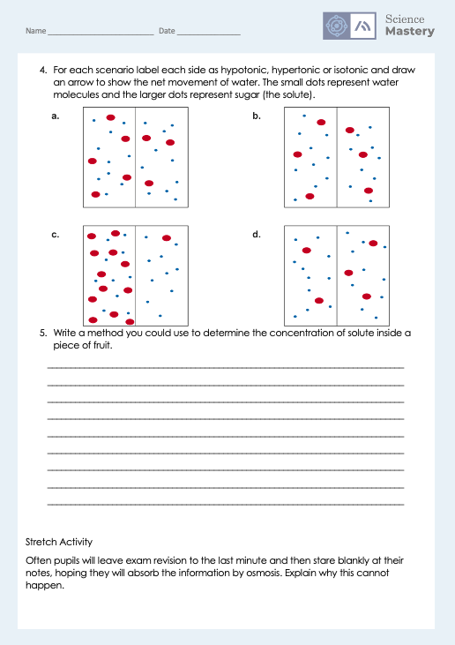
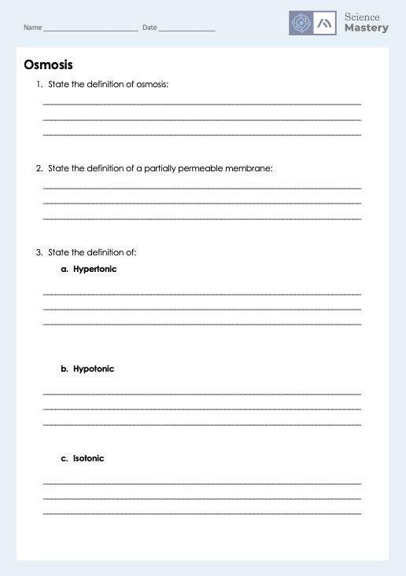
Osmosis
Complete the worksheet on osmosis
Use full sentences and keywords where necessary
Ensure you write the method in a concise and scientific way, including any dependent, independent or control variables.
Notes:
Self/peer assess using mark scheme
Scaffold method writing question if necessary for different classes. This can be done by
providing variables, key words or other key information to include in the answer
having steps partially written for students to complete
Providing all steps for students to place in the correct order.
Pairing students to write the method together, potentially taking every second step each.

Slide 22
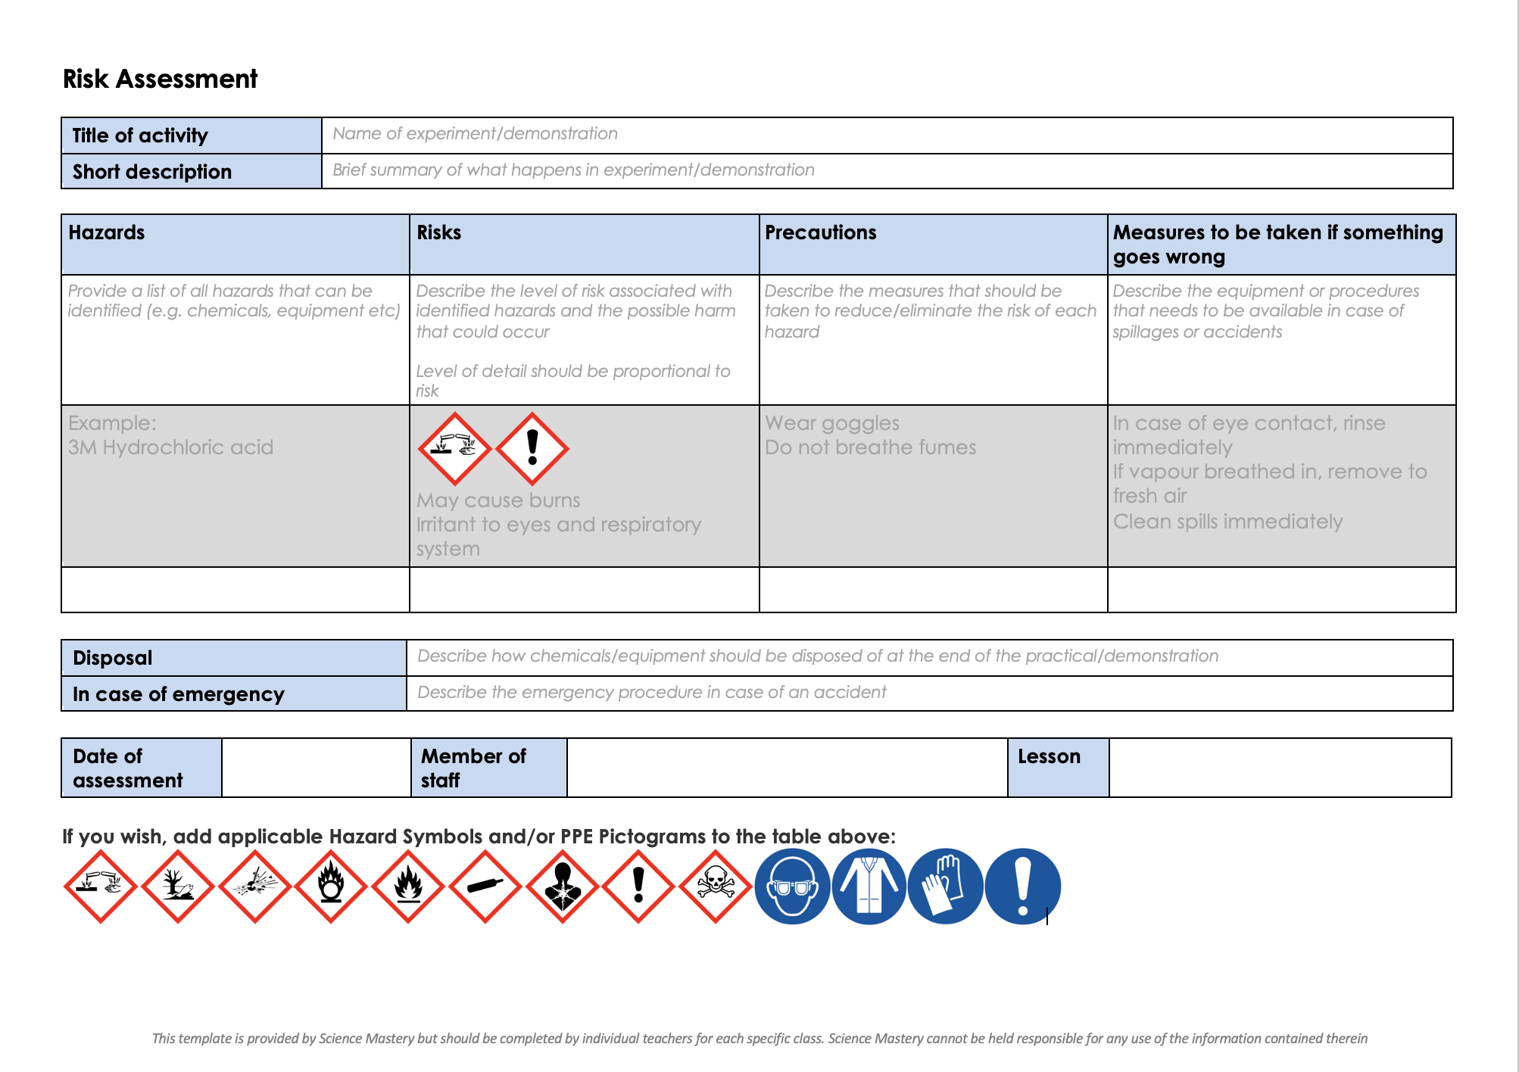
Risk Assessment
A risk assessment must be completed for this practical
The template risk assessment can be found here.

Slide 23
Investigating the effect of concentration of blackcurrant squash on osmosis in chipped potatoes
Dry the chips on a paper towel.
Weigh the chips using a balance; record masses in an appropriately designed table.
Place chips in a beaker/ boiling tube. The solutions should completely cover the chips.
Leave for at least 15 minutes.
Remove chips one at a time from the beakers/ boiling tubes.
Dry the chips on paper towel.
Reweigh chips and record results in the table.
Calculate the change in mass and then the percentage change in mass of each set of potato chips.
Stretch: Plot percentage change in mass (y-axis) against concentration of blackcurrant squash (x-axis).
Notes:
Class Practical by RSB (link: https://pbiol.rsb.org.uk/exchange-of-materials/osmosis/investigating-the-effect-of-concentration-of-blackcurrant-squash-on-osmosis-in-chipped-potatoes)
Overview: In this investigation, students will prepare a range of dilutions of blackcurrant squash. They will cut potato chips, weigh them and place them in the various solutions. Leave them for osmosis to occur. Remove the potato chips from the blackcurrant squash, dry and reweigh. Make qualitative observations or calculate the percentage change in mass.
Each working group (or individual students) could carry out the complete protocol. Or, working groups could be allocated tasks for the whole class, for example, setting up the range of dilutions, cutting the potato chips, recording data.
Student sheet included in folder for this activity with follow up questions and answers.
Teaching notes:
The advantage of using blackcurrant squash is that students can see at a glance which is the most concentrated solution. This means they are less likely to get the concentrations confused in the course of the procedure.
Solutions which draw water out of the potato chips are hypertonic to the cell contents – more concentrated. Solutions from which the potato chips absorb water are hypotonic. And a solution which is in equilibrium with the cell contents is isotonic.
You can modify this activity to show the rate of movement of water by osmosis. To do this, set up 6 beakers/ boiling tubes containing 100% blackcurrant squash. Place weighed, dried potato chips in each beaker/ boiling tube. Every 10 minutes, remove one set of chips, dry on paper towel and reweigh. Find out how long it takes before there is no further change in mass.
Teacher preparation:
a Label beakers/ boiling tubes with the concentrations of blackcurrant squash.
b Measure out blackcurrant squash for the dilutions using the volumes shown in column 4 of the table. Measure out water using the volumes shown in column 5. (Columns 2 and 3 show the volumes needed to make 10 cm3 of solution, which is multiplied to get larger volumes in columns 4 and 5.)
c Collect some potato chips or a potato to cut up. Cut or trim your chips, if necessary to fit into your small beaker/ boiling tube. Cut off any potato skin.

Slide 24
Answer the questions below.
Which best states the definition of osmosis?
A. Water molecules going out of cells into salty water
B. The diffusion of water molecules from a dilute solution to a concentrated solution
C. The movement of molecules from a high concentration to a low concentration
2. Which scenario would result in a turgid cell?
A. A plant cell being placed in a hypotonic solution
B. An animal cell being placed in a hypertonic solution
C. A plant cell being placed in a hypertonic solution
3. A hypotonic solution is…
A. A solution that has a higher concentration than the cell/sample
B. A solution that has the same concentration as the cell/sample
C. A solution that has a lower concentration than the cell/sample
✓
✓
✓
Notes:
Purpose: to find out if students are able to answer key questions that check for understanding of the new information that have been covered.
Answers:
Q1. Answer: B
If pupils answered A they have given an example of when diffusion happens not a definition, if they have answered C they have not got the correct idea of water concentration. To fix this ask pupils to write the definition for osmosis and explain the difference between osmosis and diffusion.
Q2. Answer: A
If pupils answered B they have not appreciated that animal cells do not become turgid. For both answers B and C the incorrect kind of solution has been identified. To fix this get pupils to draw hypotonic, hypertonic and isotonic solutions with cells in and then identify the direction of water movement.
Q3. Answer: C
If pupils answered incorrectly they do not know the difference between the types of solution. To fix this get pupils to draw hypotonic, hypertonic and isotonic solutions with cells in and then identify the direction of water movement.

Slide 25
Lesson B3.1.9
What was good about this lesson? | What can we do to improve this lesson?
Send us your feedback by clicking this link
or by emailing sciencemastery@arkonline.org
Thank you!

